Slide 1



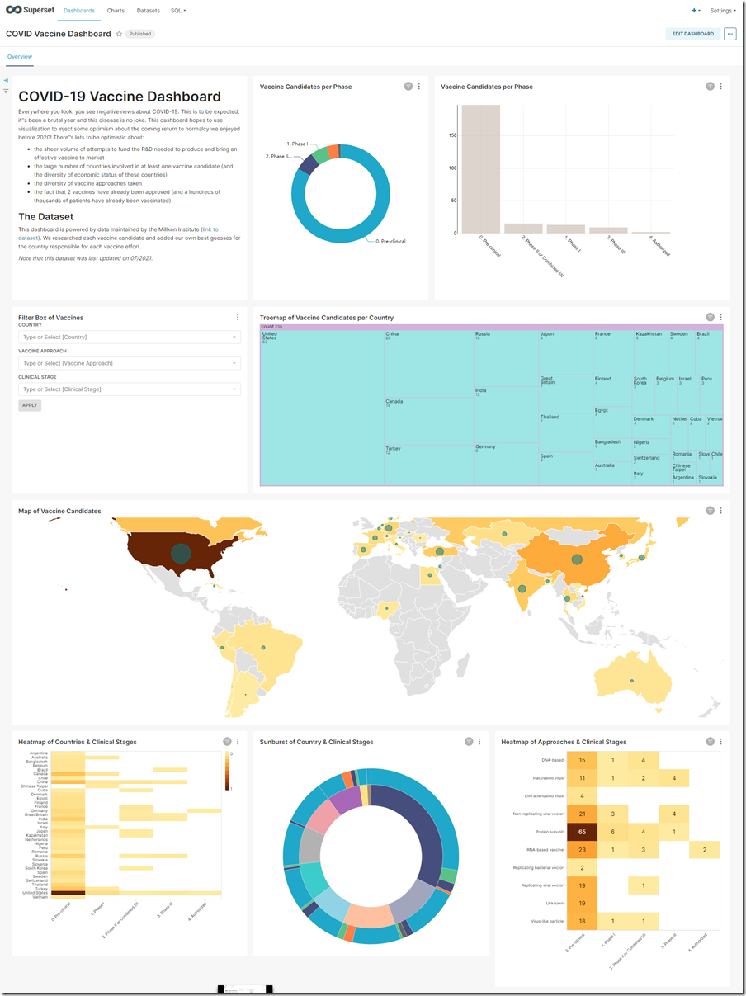
Apache Superset Data Exploration, Visualization & Analysis co-star: Steampipe & Trino
SQL
Conclusion Code Café – 20 maart 2023
Lucas Jellema, CTO & Architect AMIS | Conclusion

Slide 2
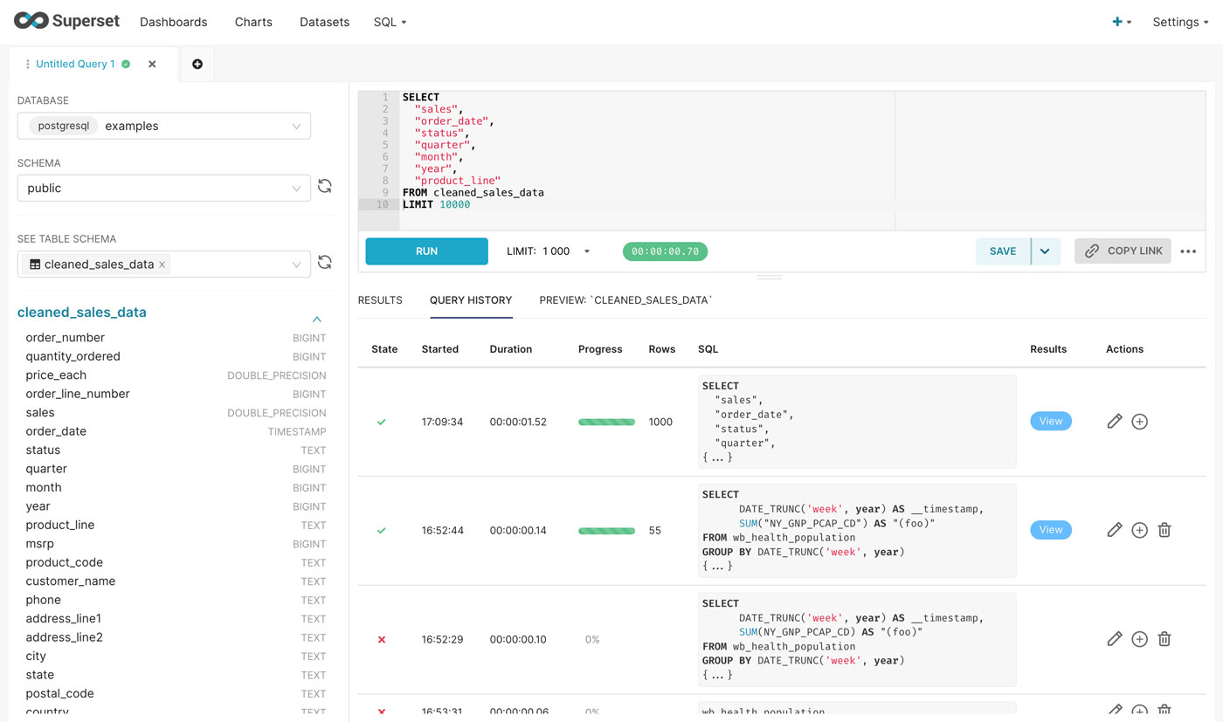
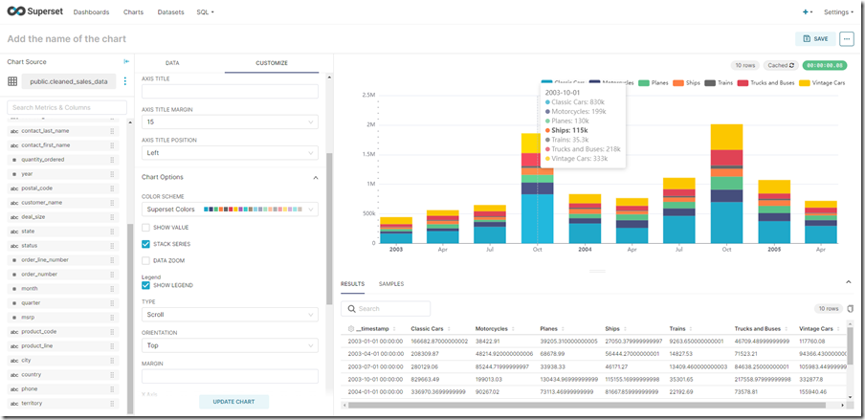
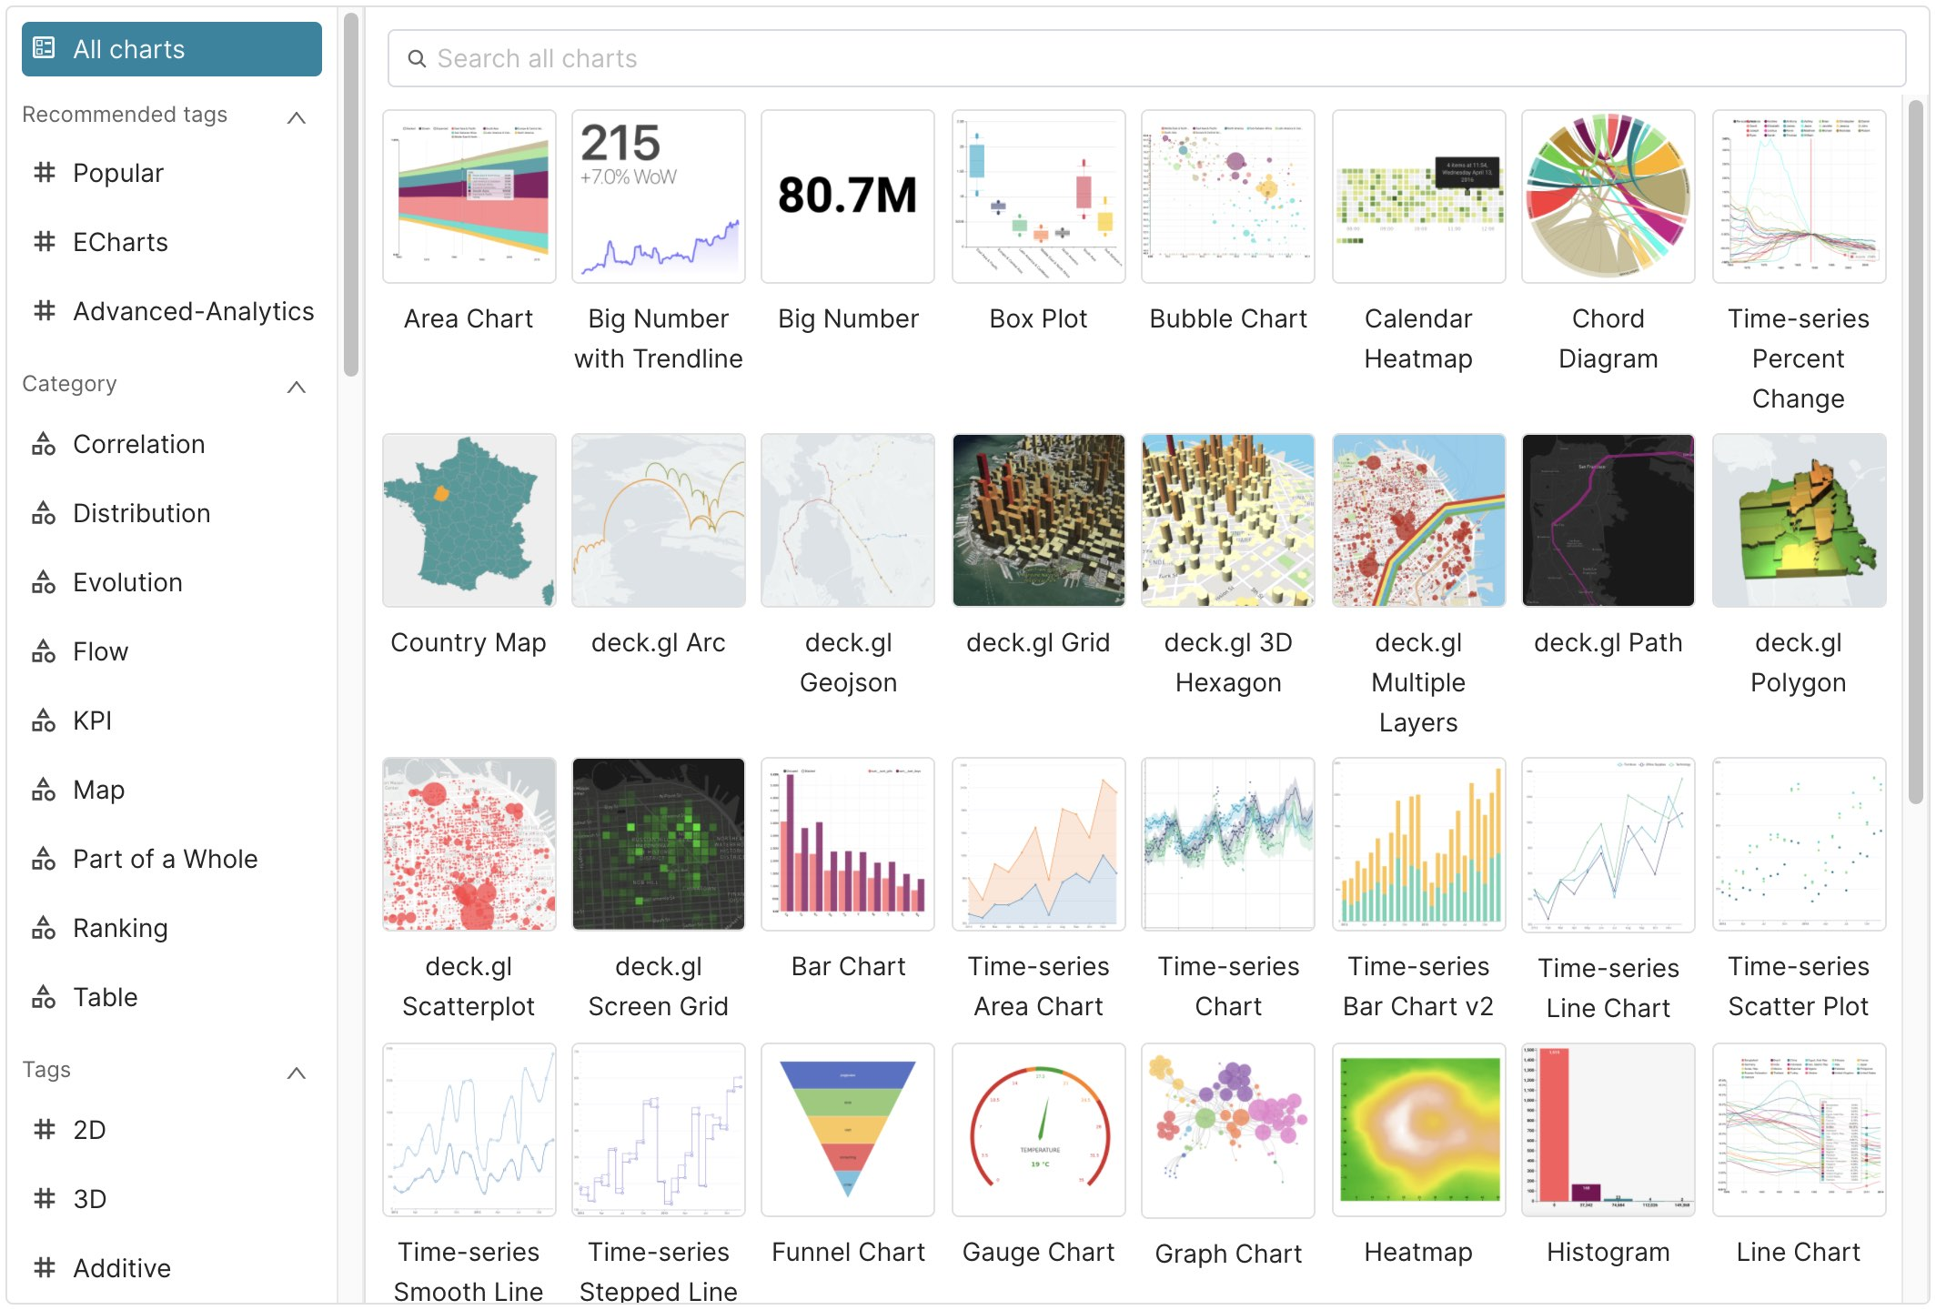
Apache Superset
Data Visualization – ready to use product
browser based UI & web server backend
any SQL data source
quick table-to-visualization & dashboard
open source, end user friendly/self service
Design principles:
single or multi-user,
no data is stored in Superset (except meta-data) and ephemeral cache,
light weight & optional semantic layer
row based access control applied

Slide 3
Apache Superset
Typical workflow
connect data source and on boards “tables”
explore / filter/ aggregate / slide & dice data
create visualizations and annotate findings
compose and publish dashboards

Slide 4
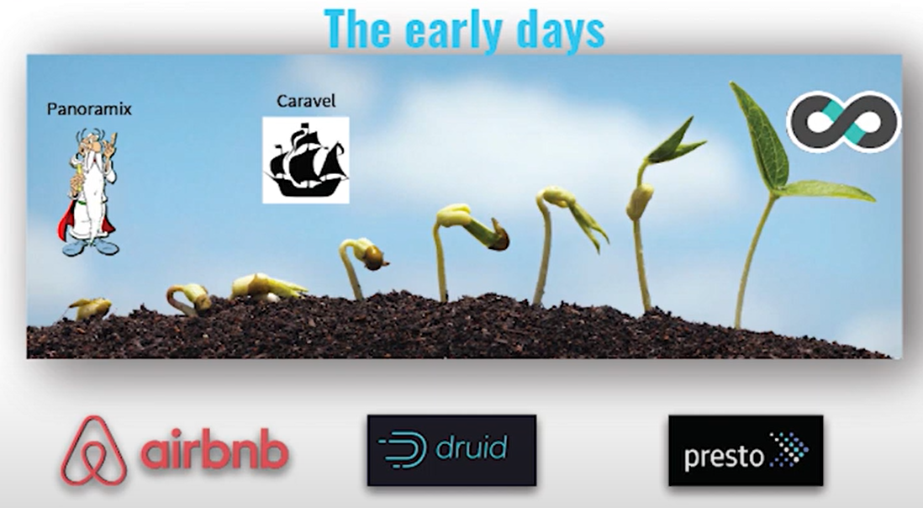
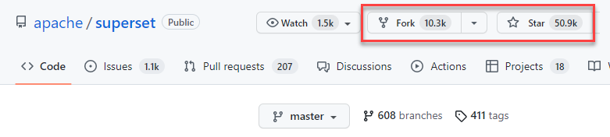

History
Originated at Airbnb in 2015 as the frontend for Apache Druid
Druid: open source multi-dimensional in memory distributed real time timeseries database
Earlier names: Panoramix & Caravel
Under Apache Software Foundation since 2017
July 2022 – Release 2.0
Tech Debt resolved, better Databricks, Pinot & Trino support, much improved UI experience
Technology stack
JavaScript: React/Redux, D3.js, webpack
Python, Flask, Pandas, SQLAlchemy
Thriving open source project
Used in many companies. Example: Airbnb – 600+ daily users, 100K+ charts
Offered as SaaS: Preset

Slide 5
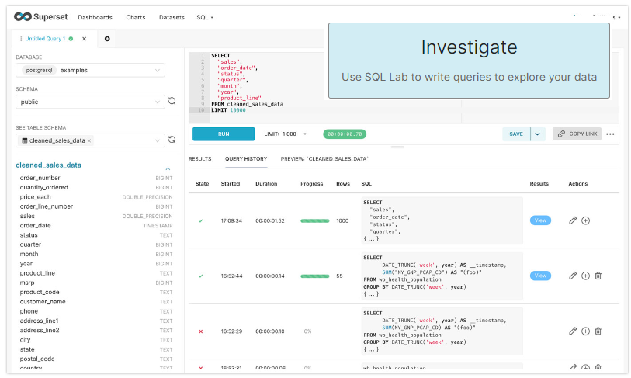
How to work with Apache Superset?
Install, Configure & Run => for example Kubernetes, Docker Compose, Gitpod
Configure Database Connection(s)
or upload CSV data files
Define Data Set(s) based on “Tables”
explore/refine in SQL Lab
define “Ninja Templates” – custom filters for specific SQL or context data

Slide 6
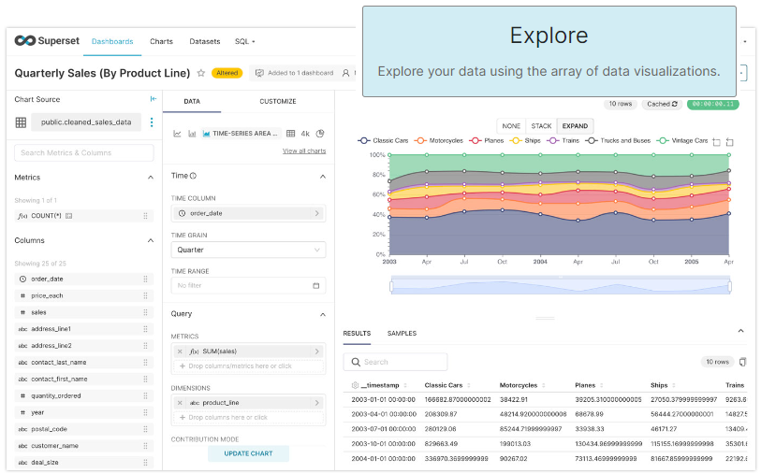
How to work with Apache Superset?
Install, Configure & Run => for example Kubernetes, Docker Compose, Gitpod
Configure Database Connection(s)
or upload CSV data files
Define Data Set(s) based on “Tables”
explore/refine in SQL Lab
define “Ninja Templates” – custom filters for specific SQL or context data
Create a Chart on that Data Set
select type of visualization
map data to visualization (x, y, series, time, ..)
configure chart: color-scheme, titles, legend
annotate chart – provide commentary
publish chart – image, CSV/Excel/JSON, email, add to dashboard
define alerts (on SQL condition) and schedule reports – Slack or Email
Compose and Expose dashboard

Slide 7
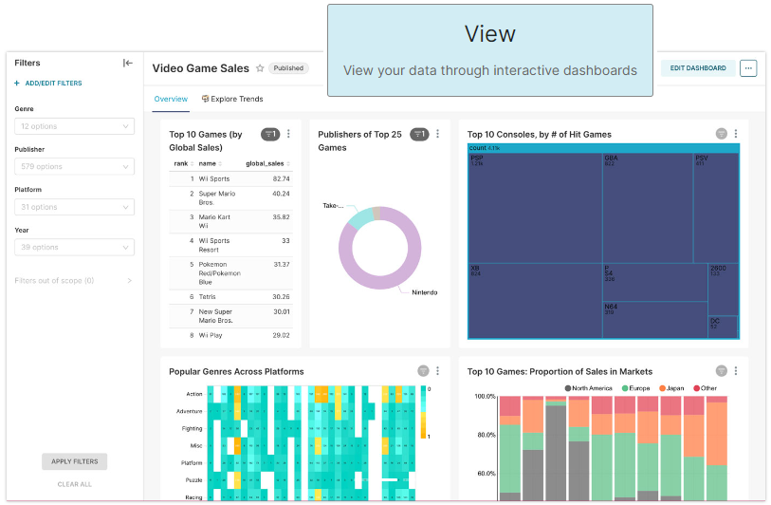
How to work with Apache Superset?
Install, Configure & Run Configure Database Connection(s)
Define Data Set(s) based on “Tables”
Create a Chart on that Data Set
Compose and Expose dashboard

Slide 8

Demo Apache Superset
Create Data Set from SQL Query
Explore Data
Create Visualization
Demonstrate Dashboard
Rob Laughter on Unsplash.com
Notes:
https://unsplash.com/photos/WW1jsInXgwM

Slide 9
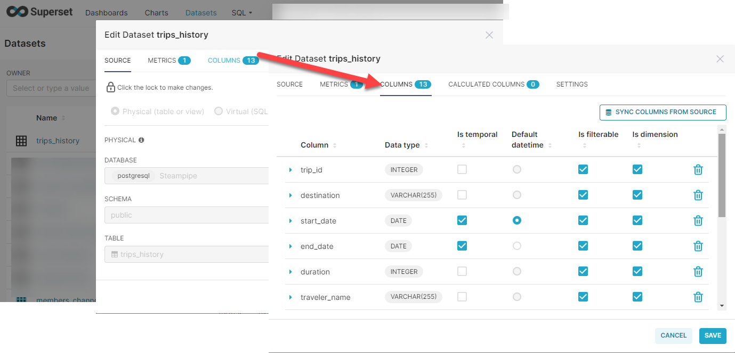
Define Data Set for SQL Table or View

Slide 10
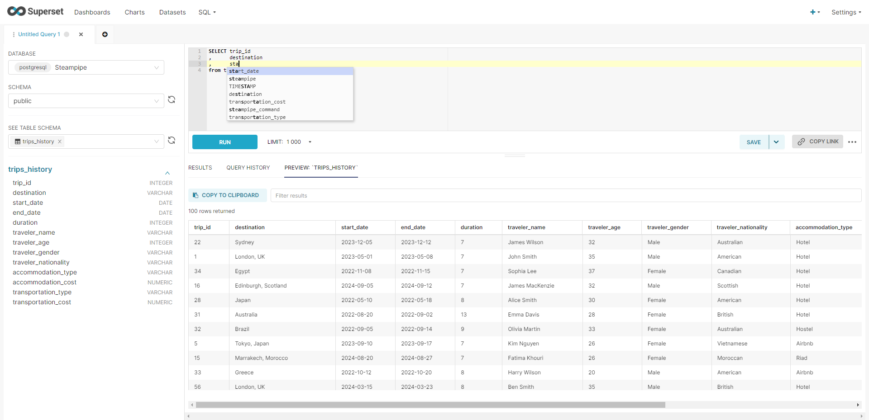
Explore Data

Slide 11
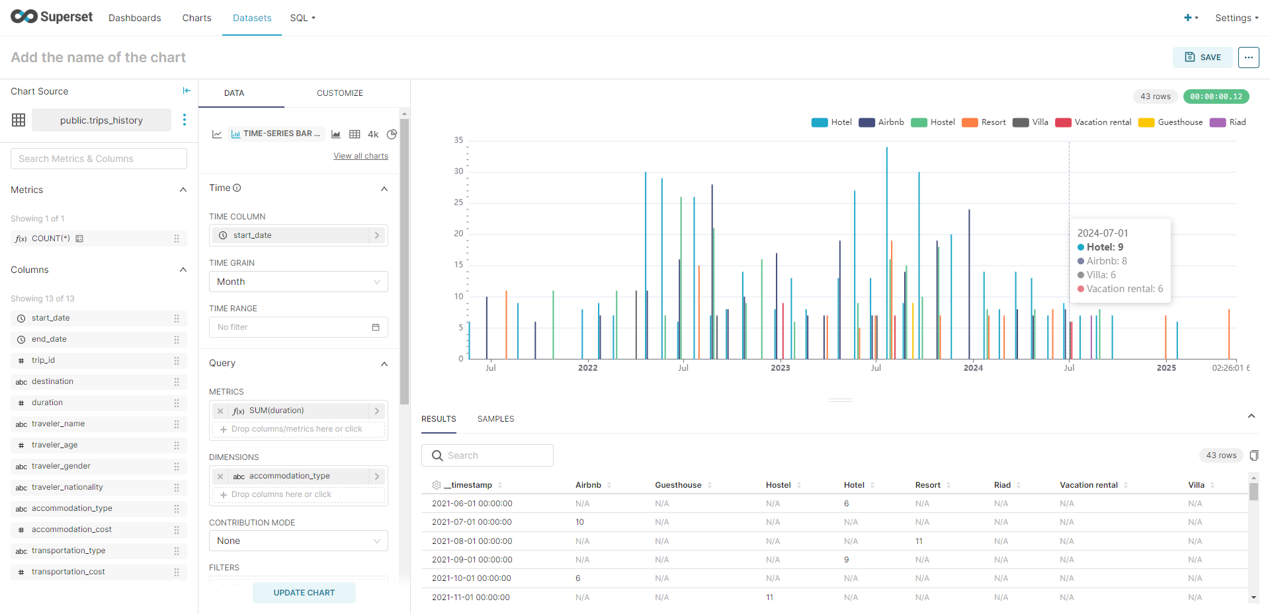
Visualize Data Set

Slide 12
End of Demo Apache Superset
Rob Laughter on Unsplash.com
Notes:
https://unsplash.com/photos/WW1jsInXgwM

Slide 13
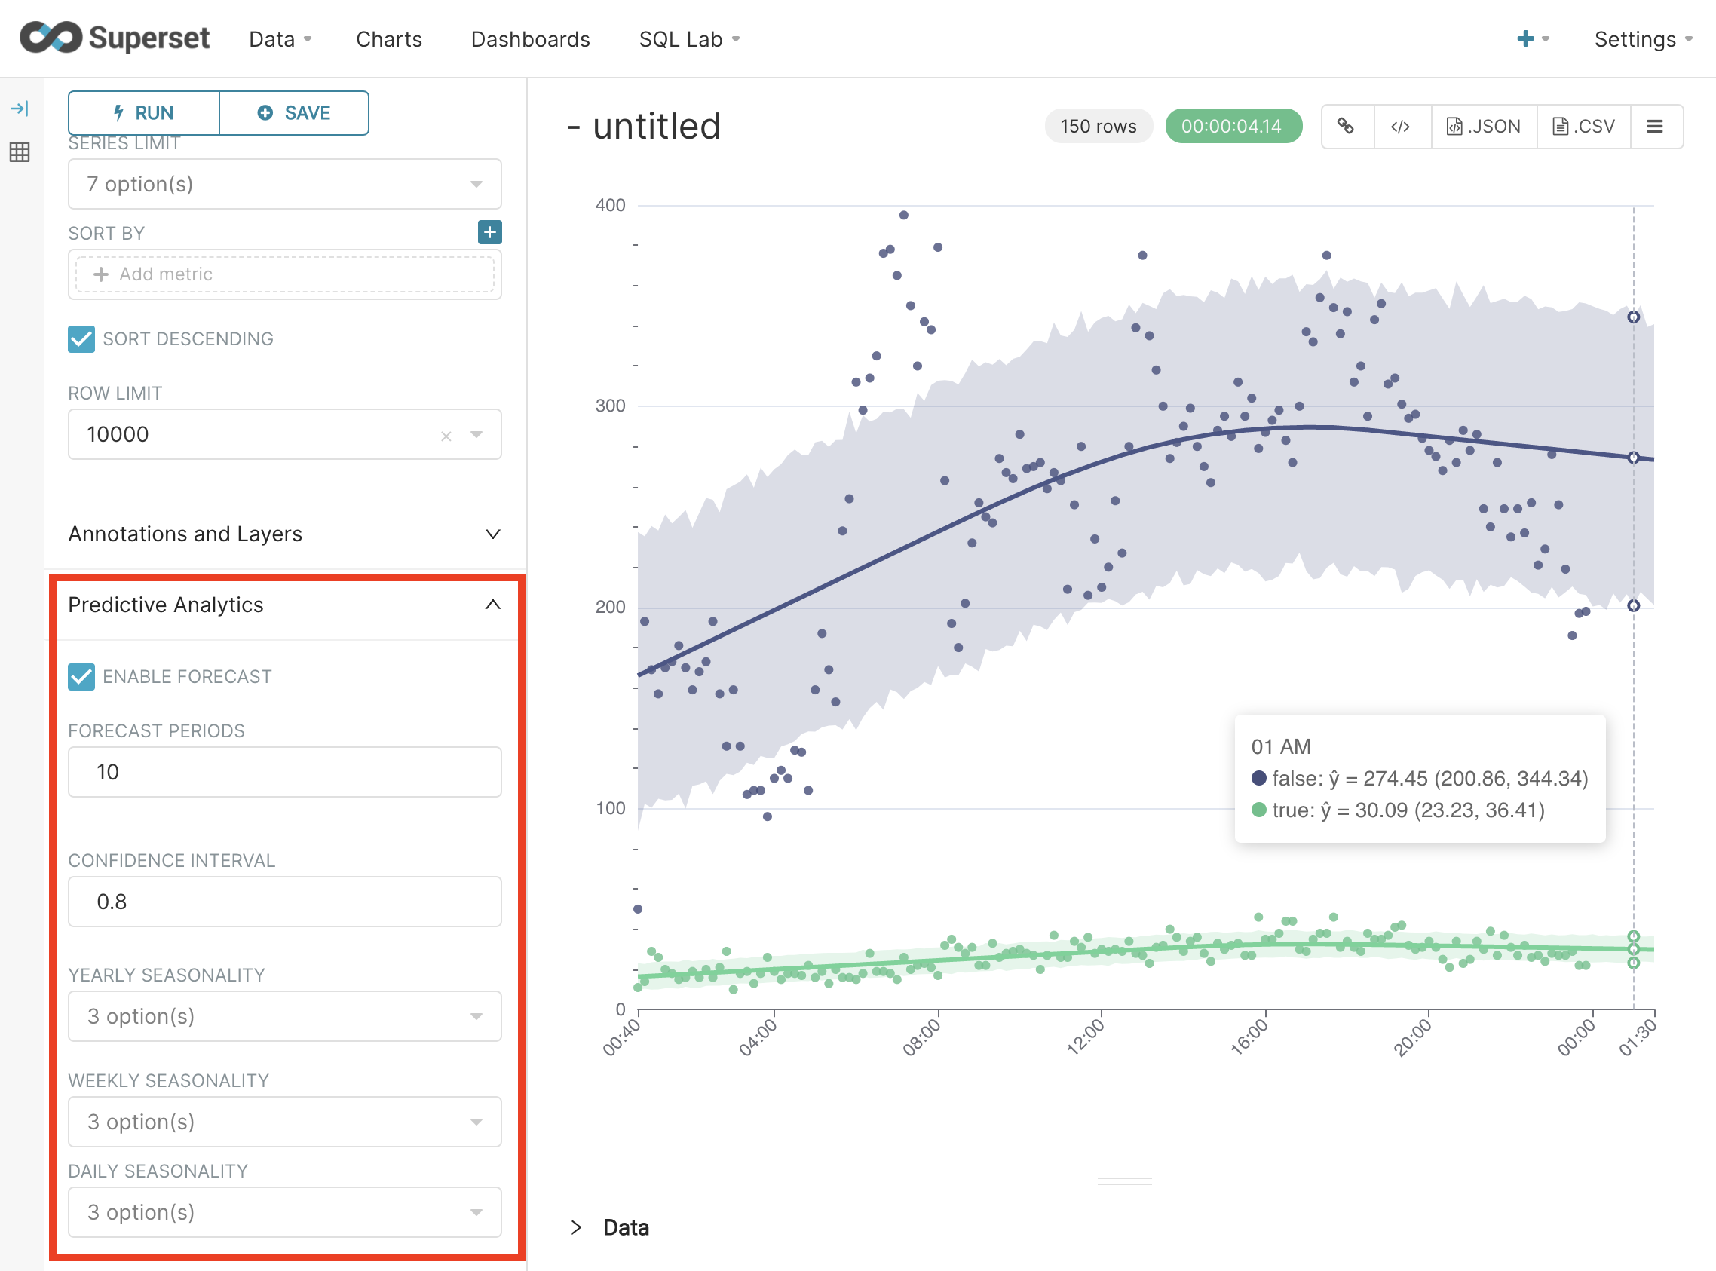
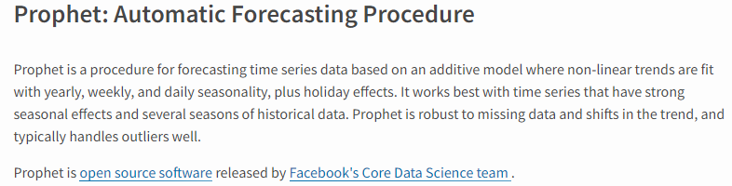
Predictive Analytics
Predict values into the future
extrapolate from past
take seasonality into consideration
Based on Prophet
open source Python

Slide 14
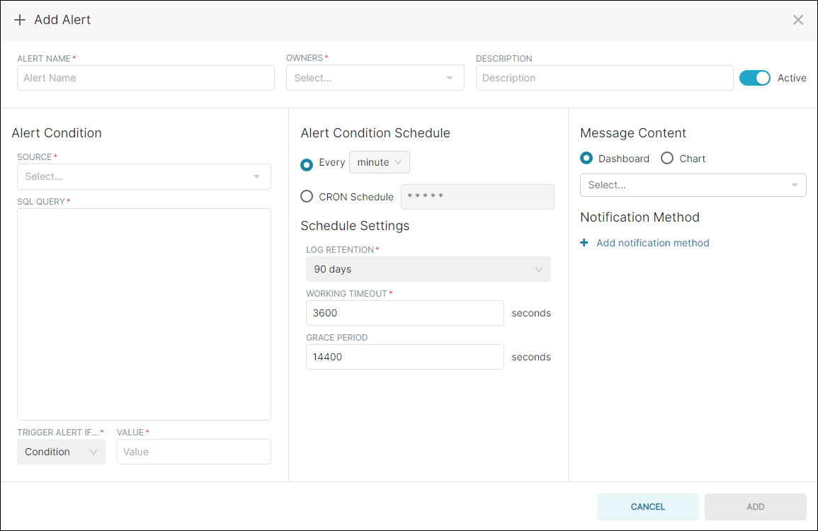
Notifications - Alarms and Scheduled Reports
When?
condition
schedule
What?
To whom?
Channel/Method?

Slide 15
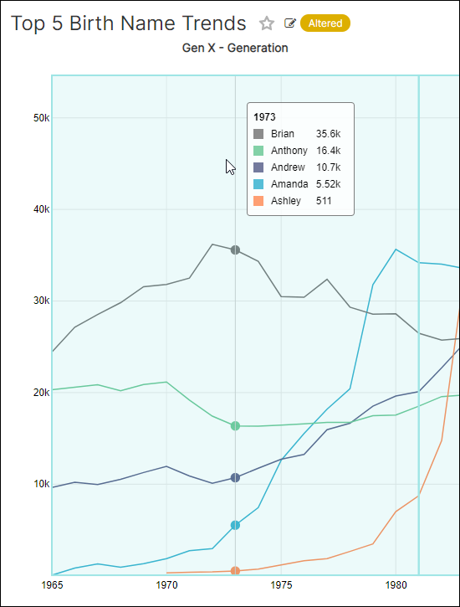
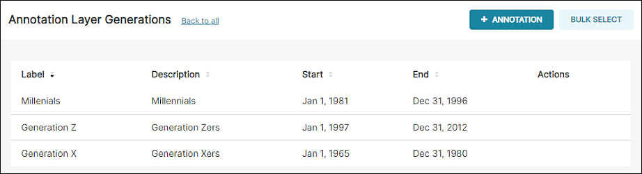
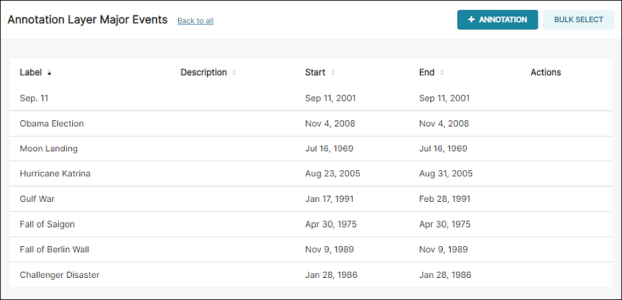
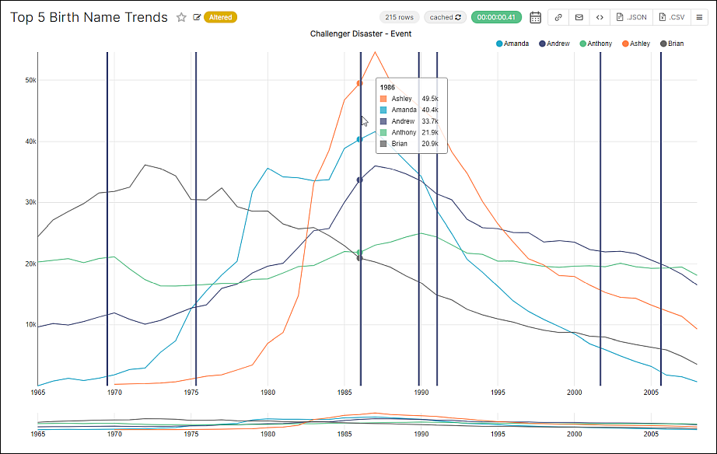
Annotation – Multiple Layers – Label Time Intervals and Timestamps

Slide 16
Security
Users identified through OAuth2 providers such as GitHub, Twitter, LinkedIn, Google, Azure, and custom OAuth2 providers
Users are associated with roles
Roles are authorized on data sources, views, dashboards
Row level access / Group level data filters
Define a security filter for a table and associate the filter with a specific group
Any data access on that table by someone in the group will have the filter applied “transparently”
Multiple filters will be combined
Group
Security Filter
SQL
table

Slide 17
Custom Visualization Plugins
Adding custom data visualizations to Superset is well supported
Steps:
Generate Skeleton for custom plugin (CLI, Yeoman)
Register plugin (JSON)
Configure plugin – valid input, labels, hooks (JSON)
Implement/link React component that actually renders data (Typescript/JS)
At runtime: Superset
exposes custom plugin in gallery
allows users to set relevant configuration for plugin
passes data – query result set – to plugin
embeds the rendered outcome appropriately in the webpage

Slide 18
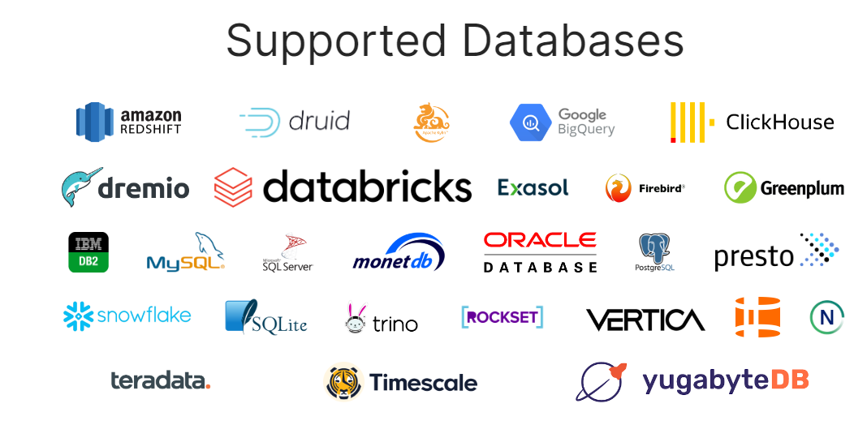



Data Source Reach of Apache Superset
Superset can process data in SQL enabled sources

Slide 19

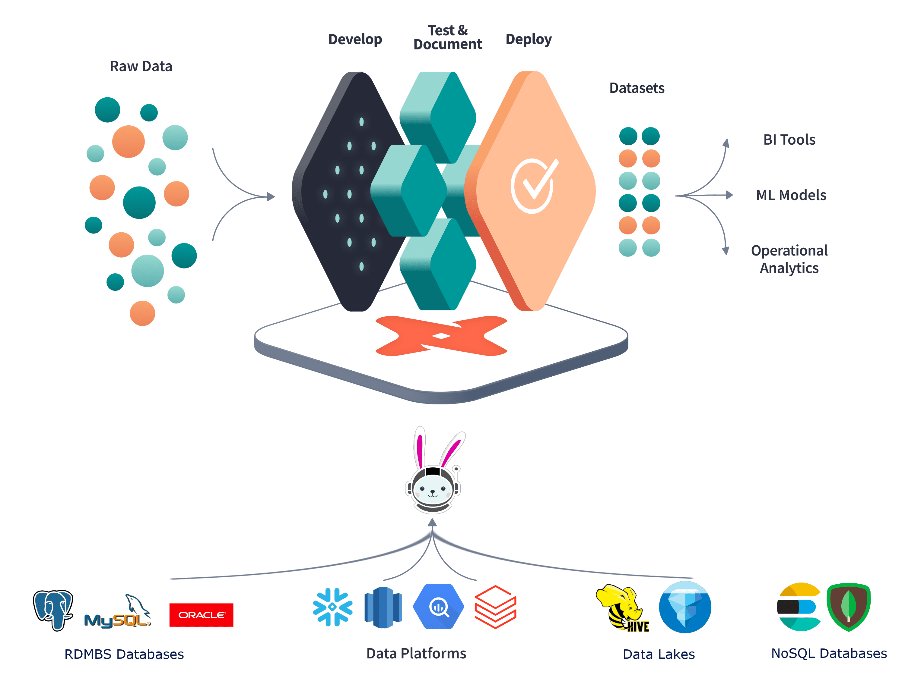
Trino (pka Presto SQL)
Distributed Federated Query Engine
OLAP system, enables data mesh
does not store data itself
MPP architecture
Trino processes SQL queries against multiple data engines
SQL and NoSQL
database and other (queue, event broker, file system, cache)
combines results across sources: join, union, group by / aggregate
Started in 2012 at Facebook as Presto
to replace Hive
Offered as SaaS by Galaxy

Slide 20
Superset can access data via Trino using SQL

Slide 21































Superset can access & combine non-SQL and SQL sources via Trino

Slide 22



















Steampipe
data can be joined, filtered, union-ed/minussed, aggregated
102 plugins for various data sources

Slide 23
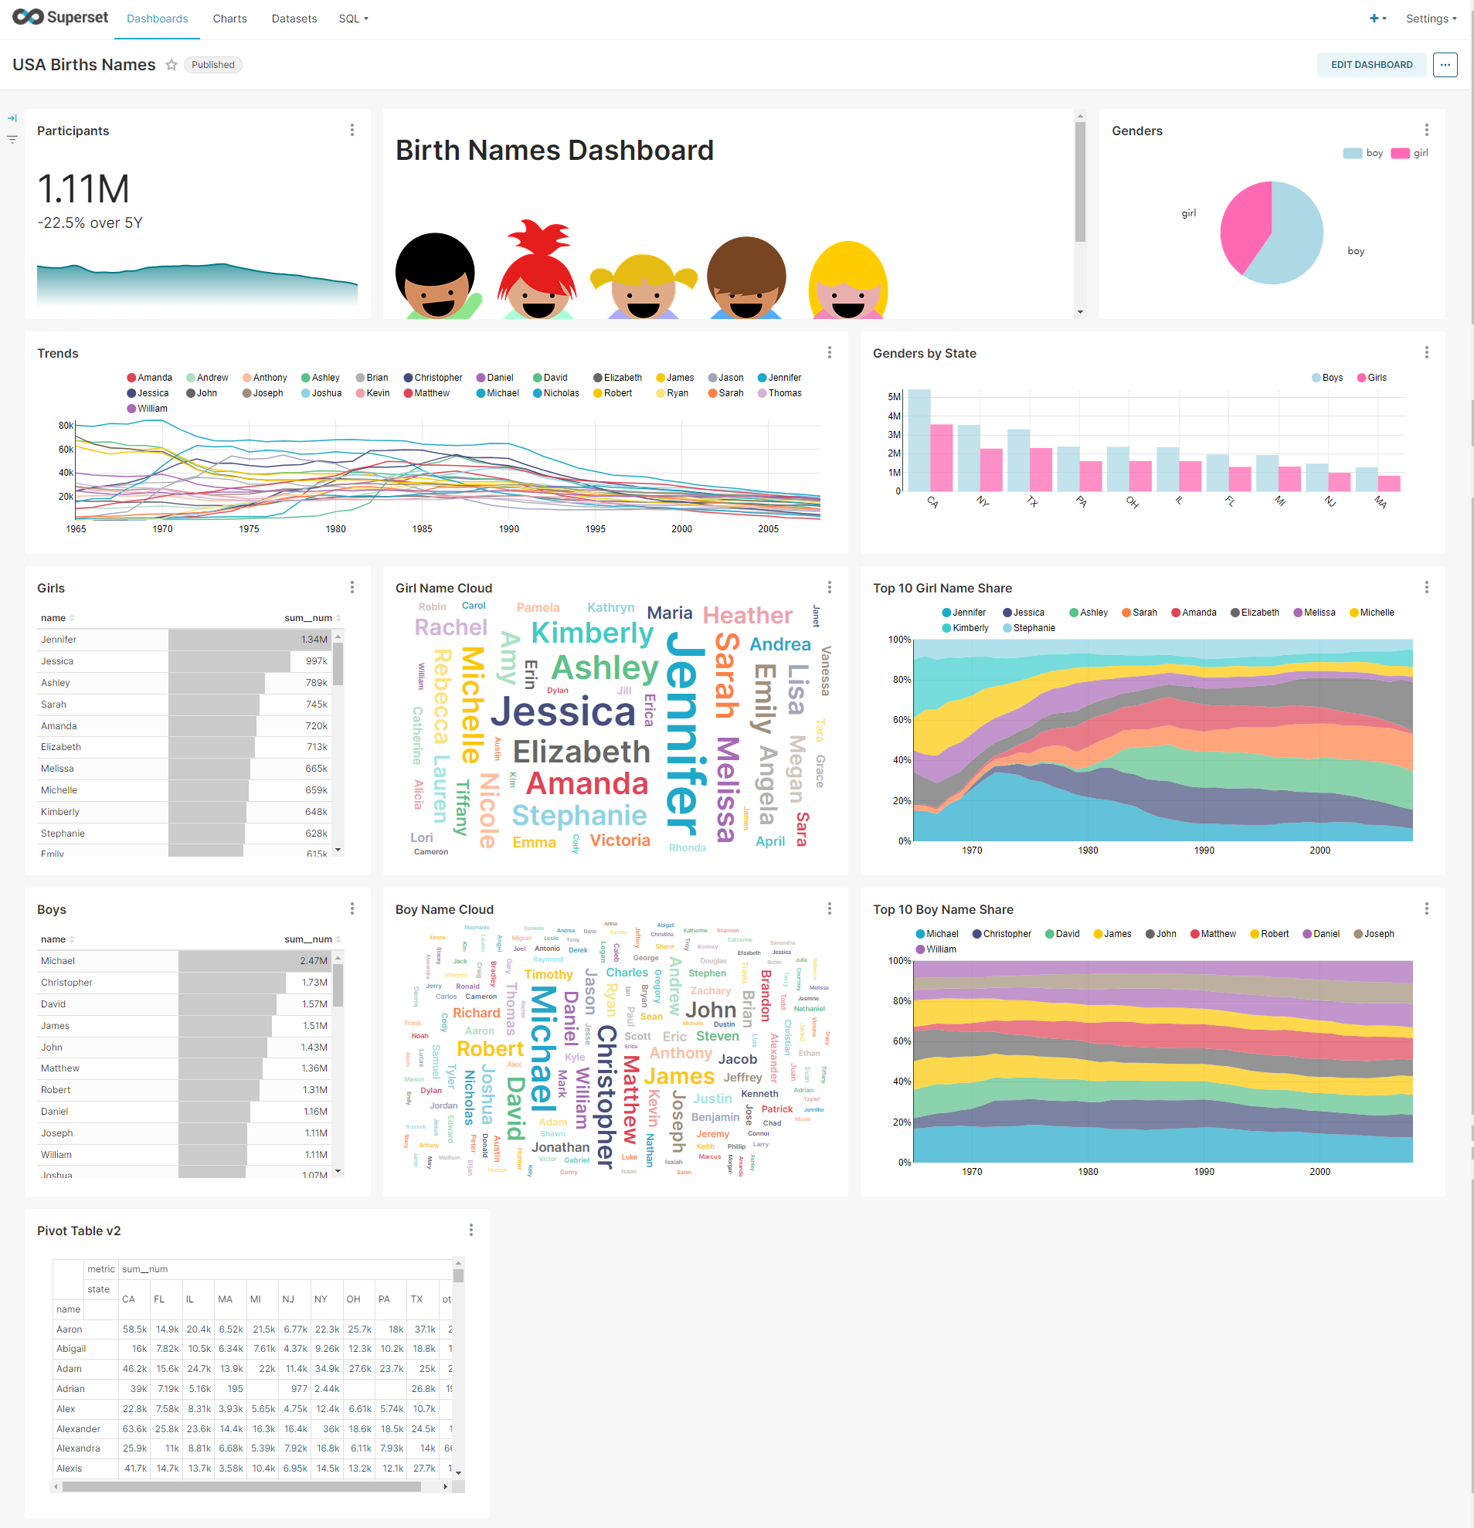
Via Steampipe – Superset has access to 100 more sources

Slide 24



Extending Source Reach of Apache Superset – across platforms, data formats, protocols and query languages
Shillelagh
Google Sheets
HTTP => JSON, CSV
GitHub
GraphQL
Datasette
HTML Table
S3
Weather API
Socrata

Slide 25
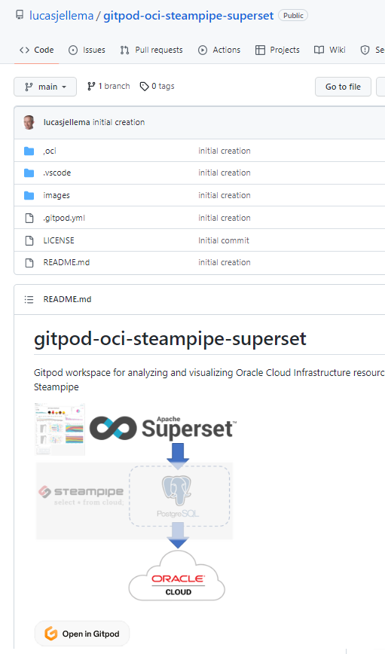
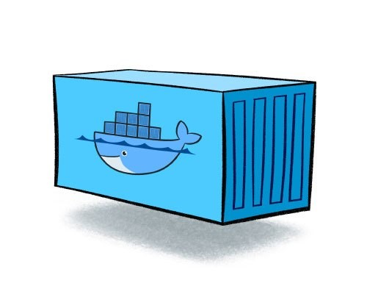





Gitpod Workspace for Trying Out Apache Superset and Steampipe
docker-compose – running 6 containers
Superset web app at port 8088
database connection
<> plugin
workspace

Slide 26
Summary
Data Visualization
Across virtually any data source (also leveraging Trino, Steampipe etc)
User friendly
Appealing, insightful visualizations
Data exploration (slice & dice)
Customizable (custom visualizations)
Open source, open architecture
Fine grained security
Free (and better?) alternative to Tableau, Qlik, PowerBI

Slide 27
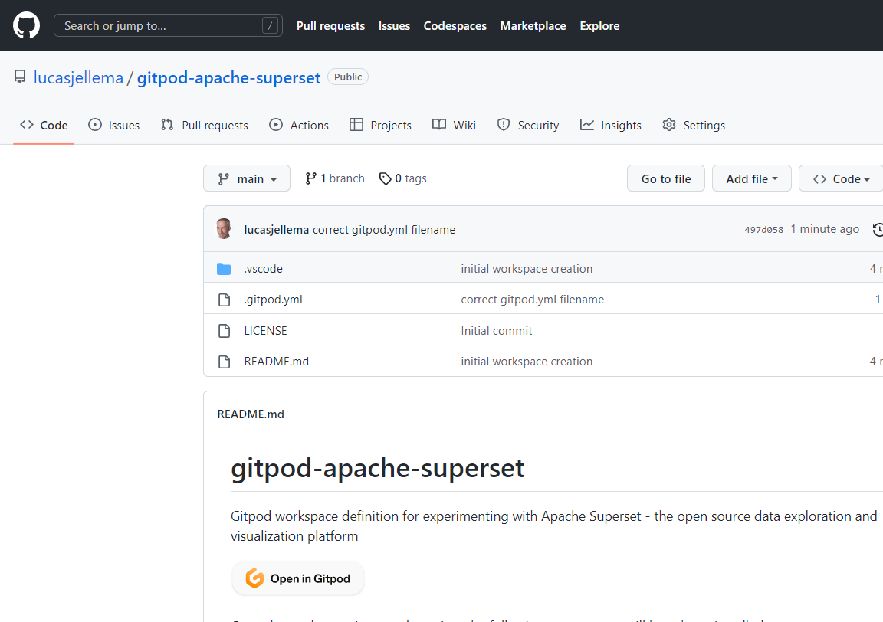
Gitpod Workspace for Trying Out Apache Superset
web app at port 8088
superset_app
superset_worker
superset_db
superset_init
superset_cache
Redis
superset_worker_beat
workspace

